Slide 1
Country Data Dashboard

Slide 2
Technology
Backend: Node.js with Express.js
Frontend: React.js with Next.js
Styling: Tailwind CSS
CI/CD Automation: GitHub Action Workflow
Map: Google Map API
Chart: Chart.js

Slide 3
App Structure
Frontend
/ - Country listing page
/countries/:code – Country Details page based on provided Country code.
/countries/compare – Statistical comparison of two countries
Backend
/countries
/ - listing Countries
/search – search by name, capital or region
/:code – Country details based on country code

Slide 4
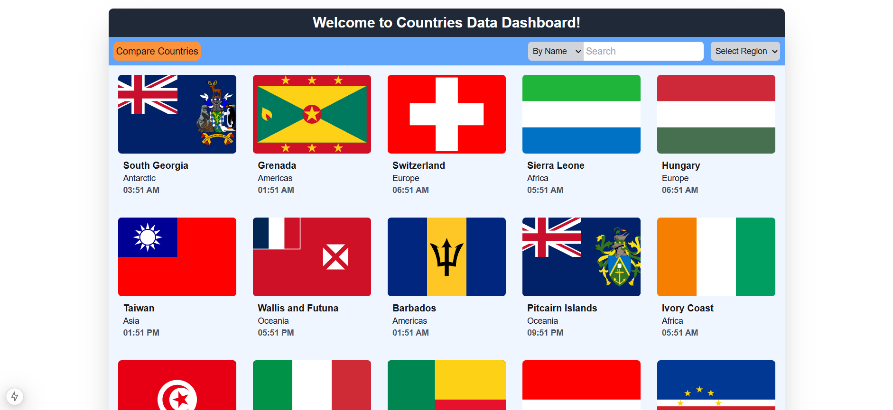
Country listing Page

Slide 5
Country listing Page
By default, all countries will be listed through infinite scrolling.
Search filter is given. By name and capital countries can be search.
Countries can be filtered based on regions by selecting the region from the dropdown.
Country Card will have a link that will redirect to Country details page to a new window.
“Country Compare” button for redirecting to the Country Comparison page.

Slide 6
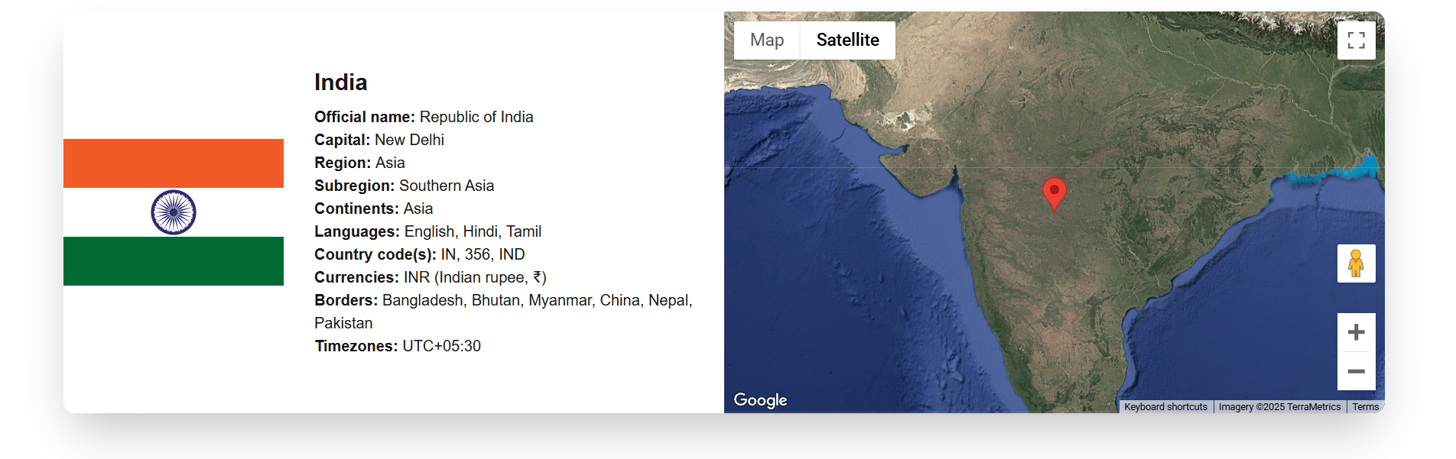
Country Details Page

Slide 7
Country Details Page
Country will be fetched based on provided country code from the URL.
On the left section, all required country details will be displayed with the country flag.
On the right side, Approximate Country map will be shown in Google Maps with the help of provided Latitude/Longitude of Country center.

Slide 8
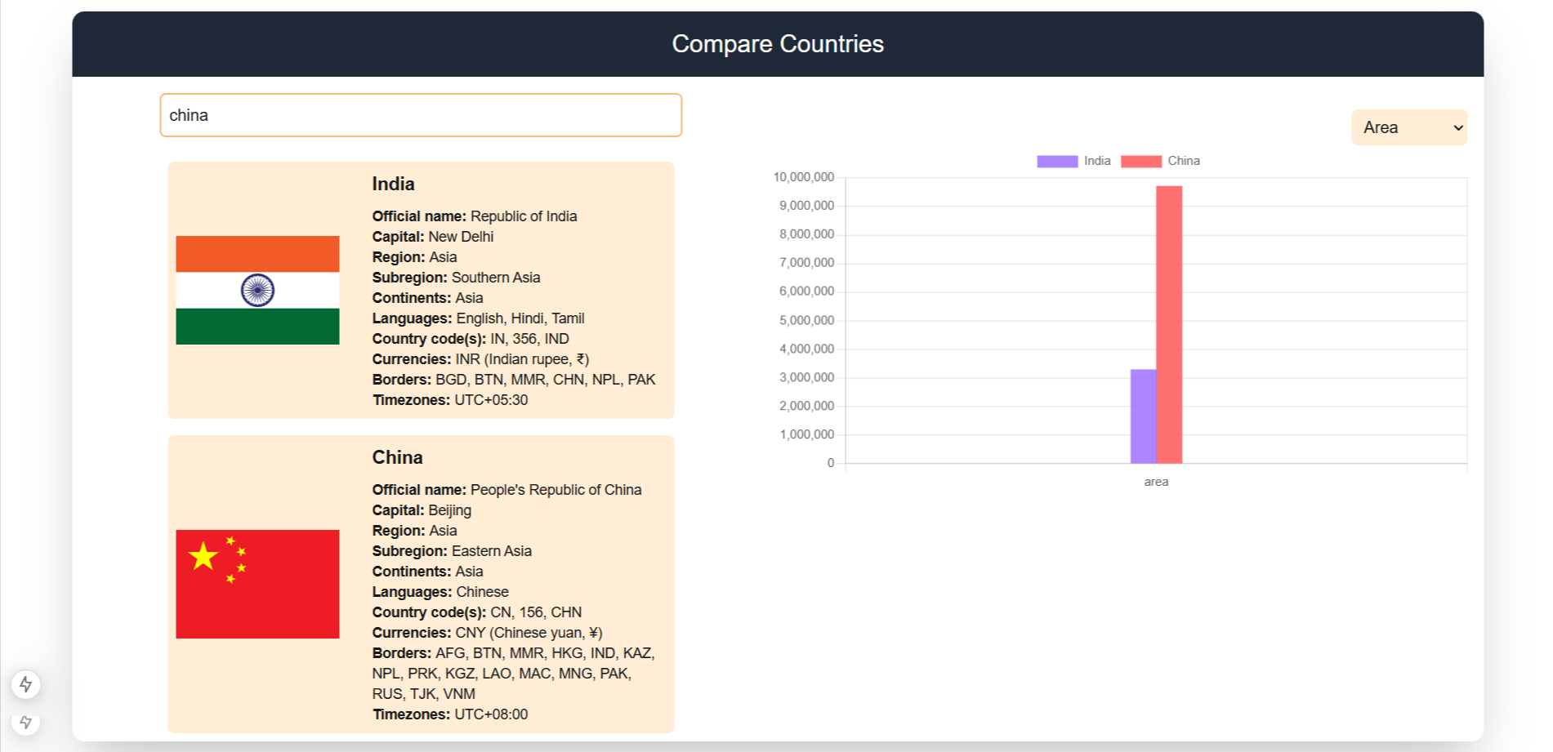
Country Comparison Page

Slide 9
Country Comparison Page
In search bar two countries can be searched one by one.
Similar details would be shown on the left side as shown in Country details page.
On the right side, Bar chart is implemented for comparing Statistics: Population and Area.

Slide 10
Performance Optimization and Best practices
Since, the project is written in Typescript, necessary type safety is in place. Custom and inbuilt Interfaces are implemented for Typescript best practices.
Exception handling and 404 page are implemented.
Considering the scope of the App, suitable logic and component segregation are practiced.
To avoid API abuse, Throttling and Debouncing are utilised.
For performance improvement, HTTP and in-memory caching are in place for Backend.
For Frontend, memoization is implemented using react hooks.

Slide 11
CI/CD Automation
GitHub Action Workflow is utilized for Automation purpose.
On Push to the main branch, App build will take place.

Slide 12
The End

